Slide 1
Distributed Computing Seminar
Lecture 3: Distributed Filesystems
Christophe Bisciglia, Aaron Kimball, & Sierra Michels-Slettvet
Google, Inc. Summer 2007
Except as otherwise noted, the content of this presentation is © Copyright University of Washington and licensed under the Creative Commons Attribution 2.5 License.

Slide 2
Outline
Filesystems Overview
NFS (Network File System)
GFS (Google File System)

Slide 3
Filesystems Overview
System that permanently stores data
Usually layered on top of a lower-level physical storage medium
Divided into logical units called “files”
  Addressable by a filename (“foo.txt”)
  Usually supports hierarchical nesting (directories)
A file path joins file & directory names into a relative or absolute address to identify a file (“/home/aaron/foo.txt”)

Slide 4
Distributed Filesystems
Support access to files on remote servers
Must support concurrency
  Make varying guarantees about locking, who “wins” with concurrent writes, etc...
  Must gracefully handle dropped connections
Can offer support for replication and local caching
Different implementations sit in different places on complexity/feature scale

Slide 5
NFS
First developed in 1980s by Sun
Presented with standard UNIX FS interface
Network drives are mounted into local directory hierarchy

Slide 6
NFS Protocol
Initially completely stateless
  Operated over UDP; did not use TCP streams
  File locking, etc., implemented in higher-level protocols
Modern implementations use TCP/IP & stateful protocols

Slide 7
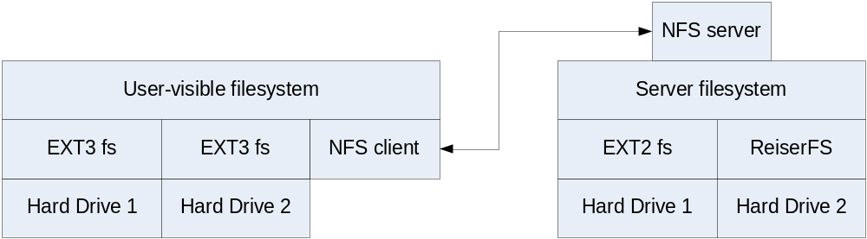
Server-side Implementation
NFS defines a virtual file system
  Does not actually manage local disk layout on server
Server instantiates NFS volume on top of local file system
  Local hard drives managed by concrete file systems (EXT, ReiserFS, ...)
  Other networked FS's mounted in by...?

Slide 8
NFS Locking
NFS v4 supports stateful locking of files
  Clients inform server of intent to lock
  Server can notify clients of outstanding lock requests
  Locking is lease-based: clients must continually renew locks before a timeout
  Loss of contact with server abandons locks

Slide 9
NFS Client Caching
NFS Clients are allowed to cache copies of remote files for subsequent accesses
Supports close-to-open cache consistency
  When client A closes a file, its contents are synchronized with the master, and timestamp is changed
  When client B opens the file, it checks that local timestamp agrees with server timestamp. If not, it discards local copy.
  Concurrent reader/writers must use flags to disable caching

Slide 10
NFS: Tradeoffs
NFS Volume managed by single server
  Higher load on central server
  Simplifies coherency protocols
Full POSIX system means it “drops in” very easily, but isn’t “great” for any specific need

Slide 11
The Google File System
Sanjay Ghemawat, Howard Gobioff,
and Shun-Tak Leung
SOSP 2003
(These slides by Alex Moshchuk, University of Washington – used with permission)

Slide 12
Motivation
Google needed a good distributed file system
  Redundant storage of massive amounts of data on
  cheap and unreliable computers
Why not use an existing file system?
  Google’s problems are different from anyone else’s
    Different workload and design priorities
  GFS is designed for Google apps and workloads
  Google apps are designed for GFS

Slide 13
Assumptions
High component failure rates
  Inexpensive commodity components fail all the time
“Modest” number of HUGE files
  Just a few million
  Each is 100MB or larger; multi-GB files typical
Files are write-once, mostly appended to
  Perhaps concurrently
Large streaming reads
High sustained throughput favored over low latency

Slide 14
GFS Design Decisions
Files stored as chunks
  Fixed size (64MB)
Reliability through replication
  Each chunk replicated across 3+ chunkservers
Single master to coordinate access, keep metadata
  Simple centralized management
No data caching
  Little benefit due to large data sets, streaming reads
Familiar interface, but customize the API
  Simplify the problem; focus on Google apps
  Add snapshot and record append operations

Slide 15
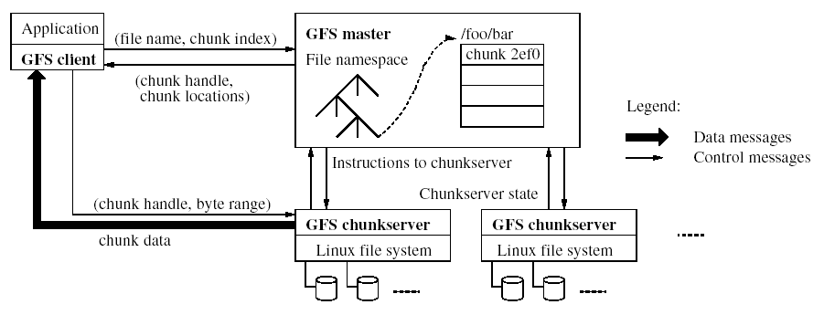
GFS Architecture
Single master
Mutiple chunkservers
…Can anyone see a potential weakness in this design?

Slide 16
Single master
From distributed systems we know this is a:
  Single point of failure
  Scalability bottleneck
GFS solutions:
  Shadow masters
  Minimize master involvement
    never move data through it, use only for metadata
      and cache metadata at clients
    large chunk size
    master delegates authority to primary replicas in data mutations (chunk leases)
Simple, and good enough!

Slide 17
Metadata (1/2)
Global metadata is stored on the master
  File and chunk namespaces
  Mapping from files to chunks
  Locations of each chunk’s replicas
All in memory (64 bytes / chunk)
  Fast
  Easily accessible

Slide 18
Metadata (2/2)
Master has an operation log for persistent logging of critical metadata updates
  persistent on local disk
  replicated
  checkpoints for faster recovery

Slide 19
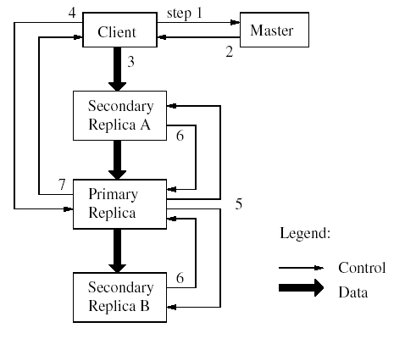
Mutations
Mutation = write or append
  must be done for all replicas
Goal: minimize master involvement
Lease mechanism:
  master picks one replica as
  primary; gives it a “lease”
  for mutations
  primary defines a serial
  order of mutations
  all replicas follow this order
Data flow decoupled from
control flow

Slide 20
Atomic record append
Client specifies data
GFS appends it to the file atomically at least once
  GFS picks the offset
  works for concurrent writers
Used heavily by Google apps
  e.g., for files that serve as multiple-producer/single-consumer queues

Slide 21
Relaxed consistency model (1/2)
“Consistent” = all replicas have the same value
“Defined” = replica reflects the mutation, consistent
Some properties:
  concurrent writes leave region consistent, but possibly undefined
  failed writes leave the region inconsistent
Some work has moved into the applications:
  e.g., self-validating, self-identifying records

Slide 22
Relaxed consistency model (2/2)
Simple, efficient
  Google apps can live with it
  what about other apps?
Namespace updates atomic and serializable

Slide 23
Master’s responsibilities (1/2)
Metadata storage
Namespace management/locking
Periodic communication with chunkservers
  give instructions, collect state, track cluster health
Chunk creation, re-replication, rebalancing
  balance space utilization and access speed
  spread replicas across racks to reduce correlated failures
  re-replicate data if redundancy falls below threshold
  rebalance data to smooth out storage and request load

Slide 24
Master’s responsibilities (2/2)
Garbage Collection
  simpler, more reliable than traditional file delete
  master logs the deletion, renames the file to a hidden name
  lazily garbage collects hidden files
Stale replica deletion
  detect “stale” replicas using chunk version numbers

Slide 25
Fault Tolerance
High availability
  fast recovery
    master and chunkservers restartable in a few seconds
  chunk replication
    default: 3 replicas.
  shadow masters
Data integrity
  checksum every 64KB block in each chunk

Slide 26
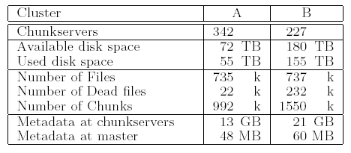
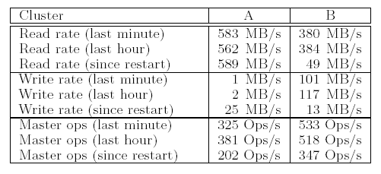
Performance

Slide 27
Deployment in Google
Many GFS clusters
hundreds/thousands of storage nodes each
Managing petabytes of data
GFS is under BigTable, etc.

Slide 28
Conclusion
GFS demonstrates how to support large-scale processing workloads on commodity hardware
  design to tolerate frequent component failures
  optimize for huge files that are mostly appended and read
  feel free to relax and extend FS interface as required
  go for simple solutions (e.g., single master)
GFS has met Google’s storage needs… it must be good!

Slide 29
Next Time...
Start learning about algorithms for distributed computation
  Clustering Algorithms

